Slide 1
Terrestrial carbon stocks
Silvia Caldararu
Email:caldaras@tcd.ie

Slide 2
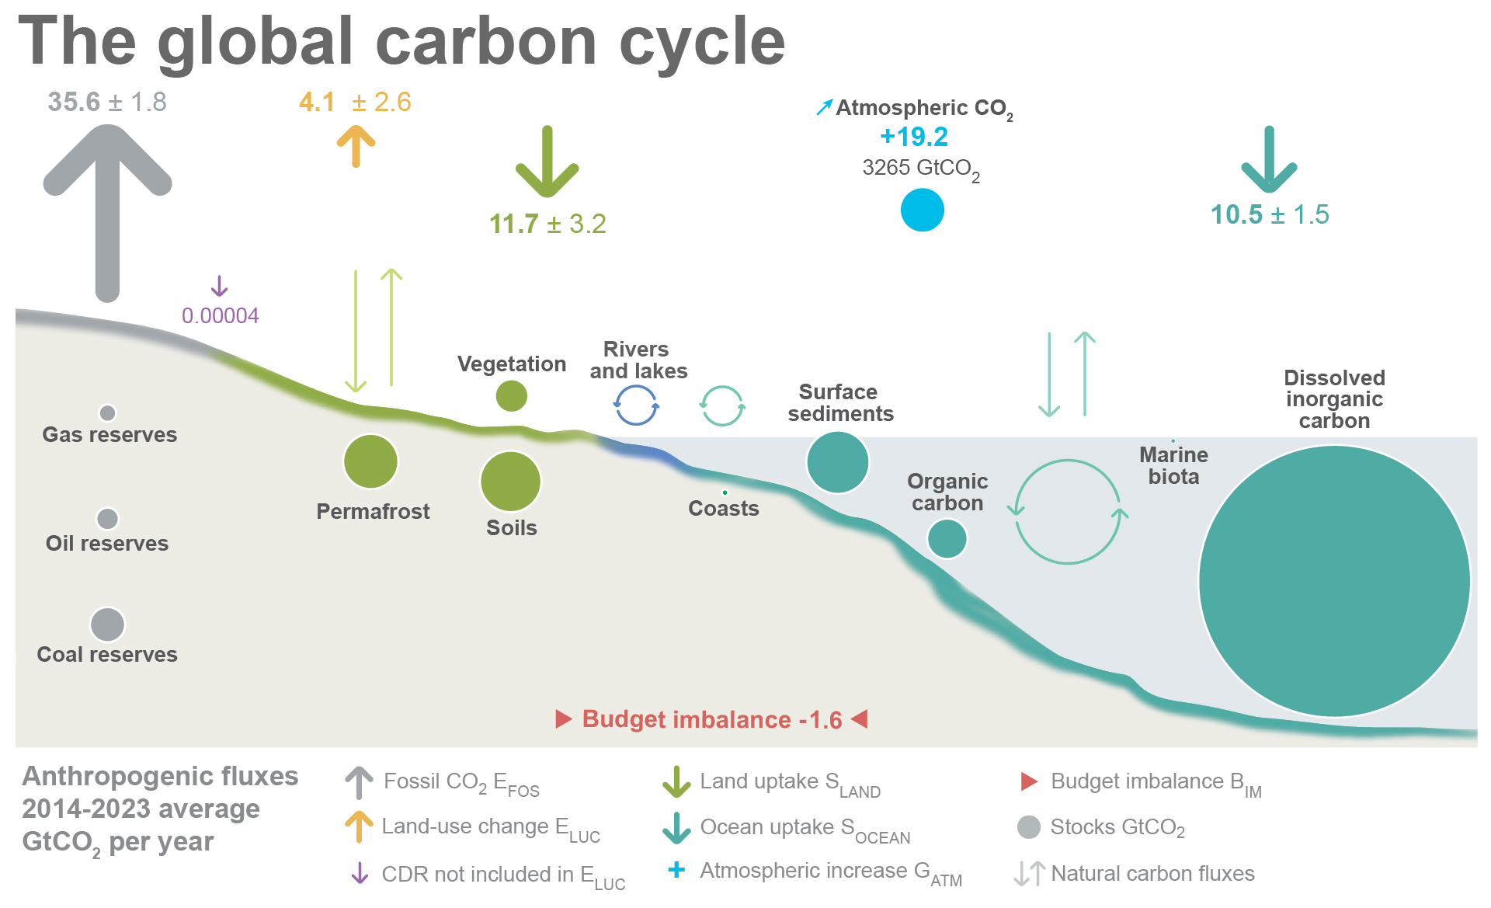

Slide 3
Useful concepts: pools and fluxes
Atmospheric CO₂
Pool: mass of carbon in a given Earth system component
(gC )
Flux: transfer of carbon compounds between pools
(gC /m2/day):
Photosynthesis and respiration
Biomass

Slide 4
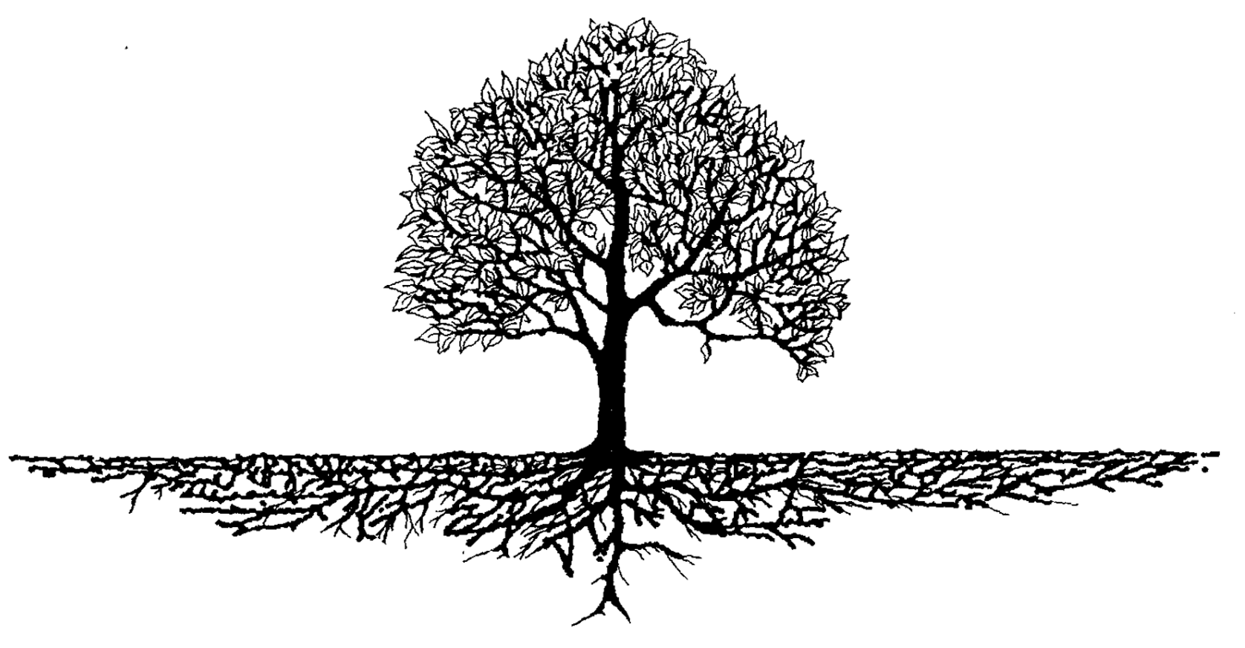
The ecosystem carbon cycle
C uptake:
photosynthesis
C release:
respiration
C release:
Soil respiration
C storage:
growth
Internal cycling::
litterfall
C storage in soil

Slide 5
Carbon available for plant growth
Net primary productivity = photosynthesis – plant respiration
NPP = GPP - R_{a}

Slide 6
Carbon allocation for plant growth

Slide 7
Short-lived plant components

Slide 8

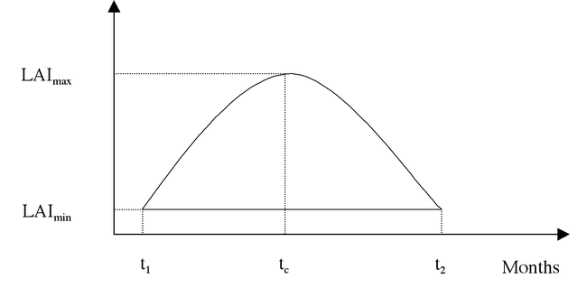
Seasonal biomass growth
Start of season: new growth
Leaf area index – amount of leaves on the plant

Slide 9
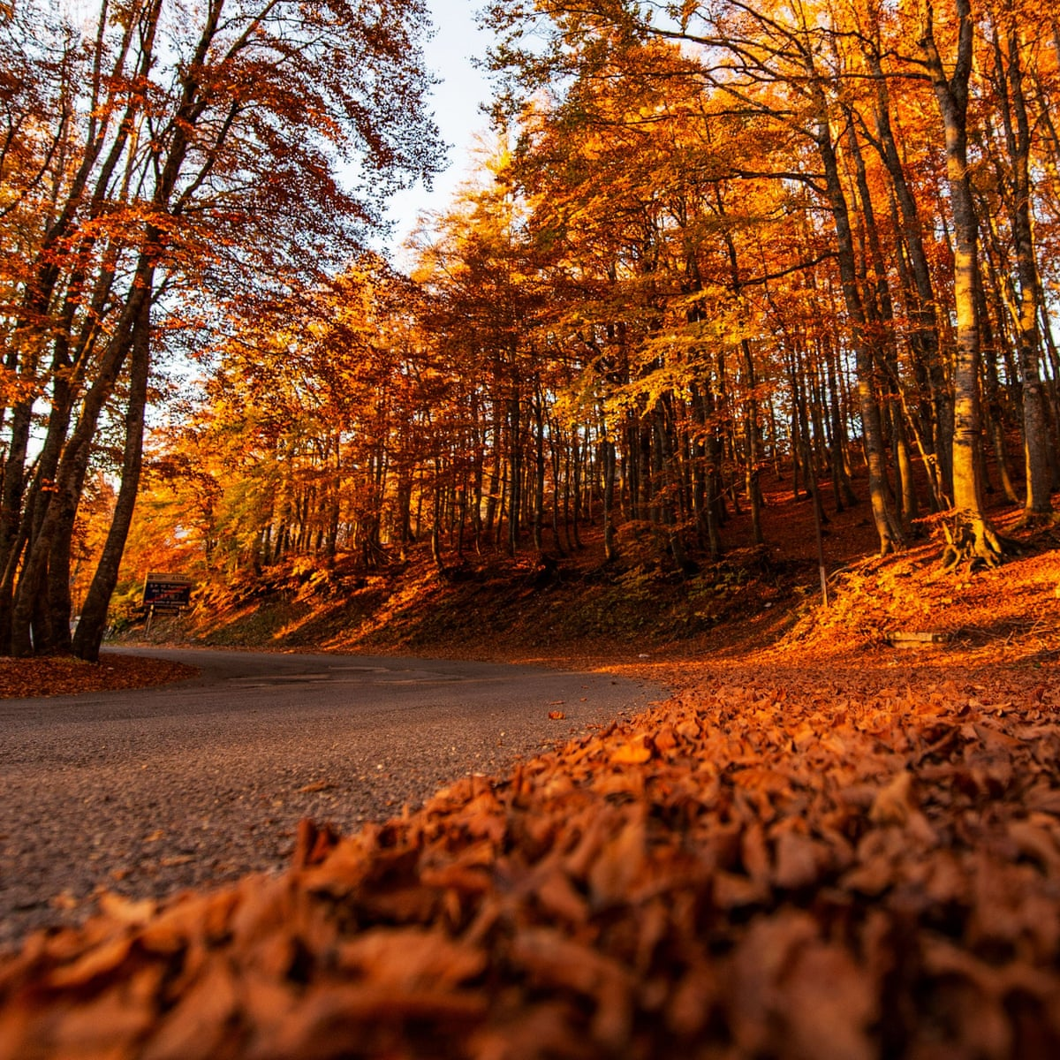
Seasonal biomass turnover
End of season: leaves are lost
Leaf area index – amount of leaves on the plant

Slide 10
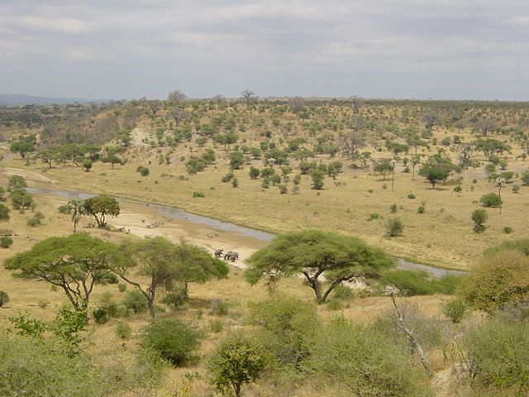
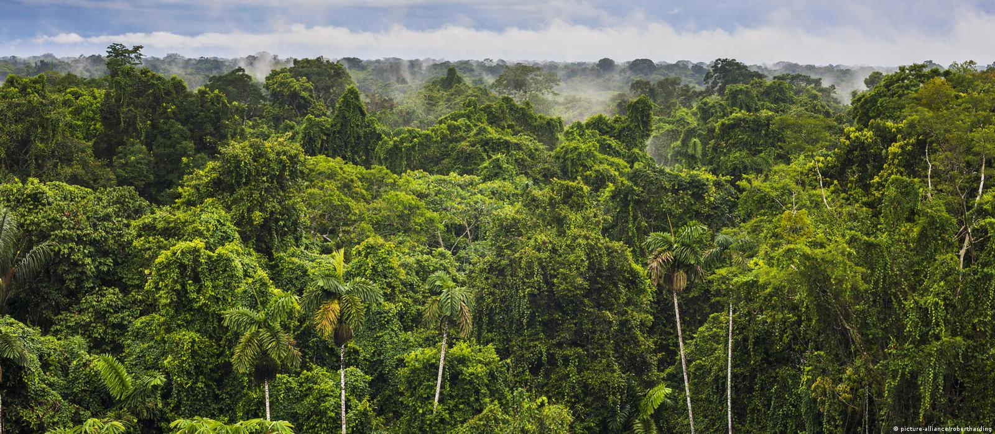
Environmental triggers for seasonal growth
Temperature in mid and high latitude regions
Water availability in seasonally dry regions
Continuous in wet tropical regions

Slide 11
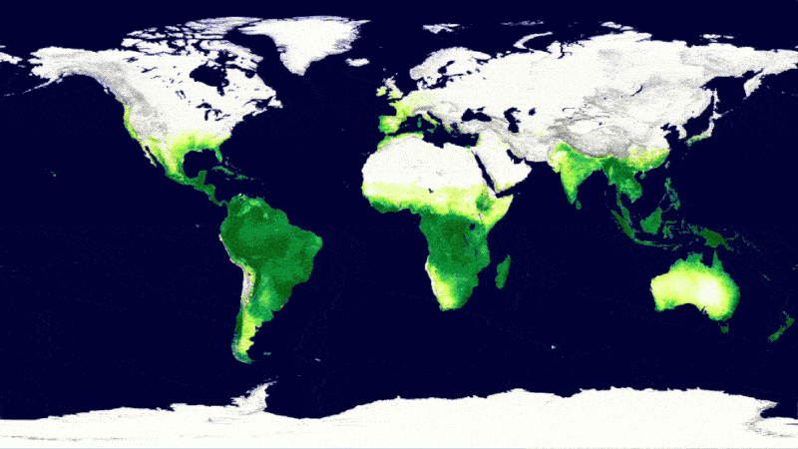
Global vegetation seasonality from space

Slide 12
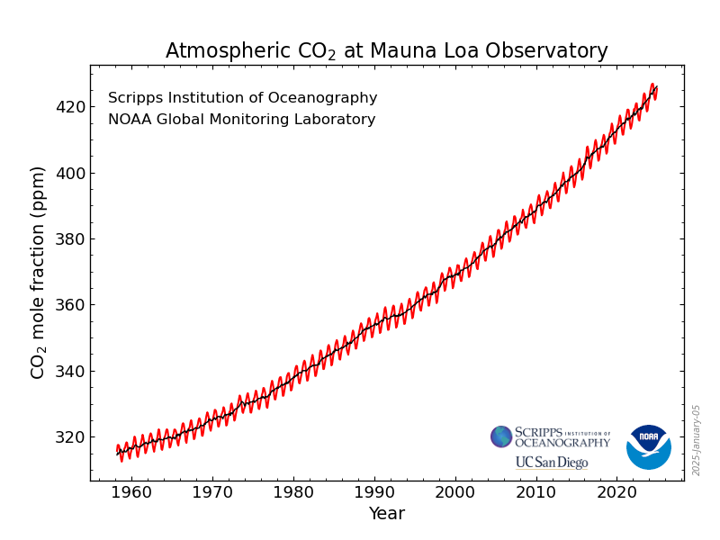
Vegetation seasonality causes the wriggles in the Keeling curve

Slide 13
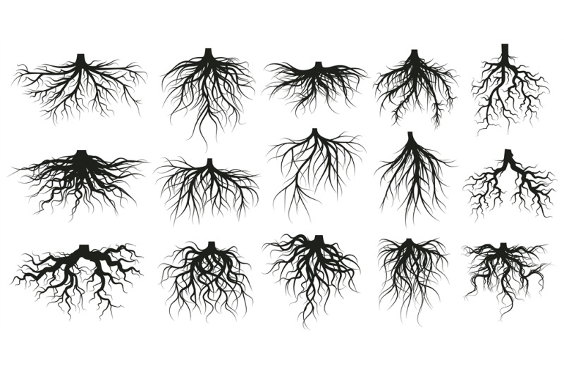
Root growth
Fine roots: functional, take up water and nutrients, short lifetime
Coarse roots: structural, woody, used for support, long lifetime
Much less well understood than leaves and stems

Slide 14
Long-lived plant components

Slide 15
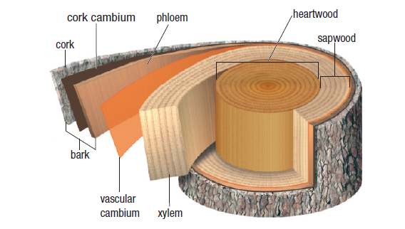
Wood formation
Living wood – transport vessels, xylem for water and phloem for organic material
Dead wood or heartwood – old living wood

Slide 16
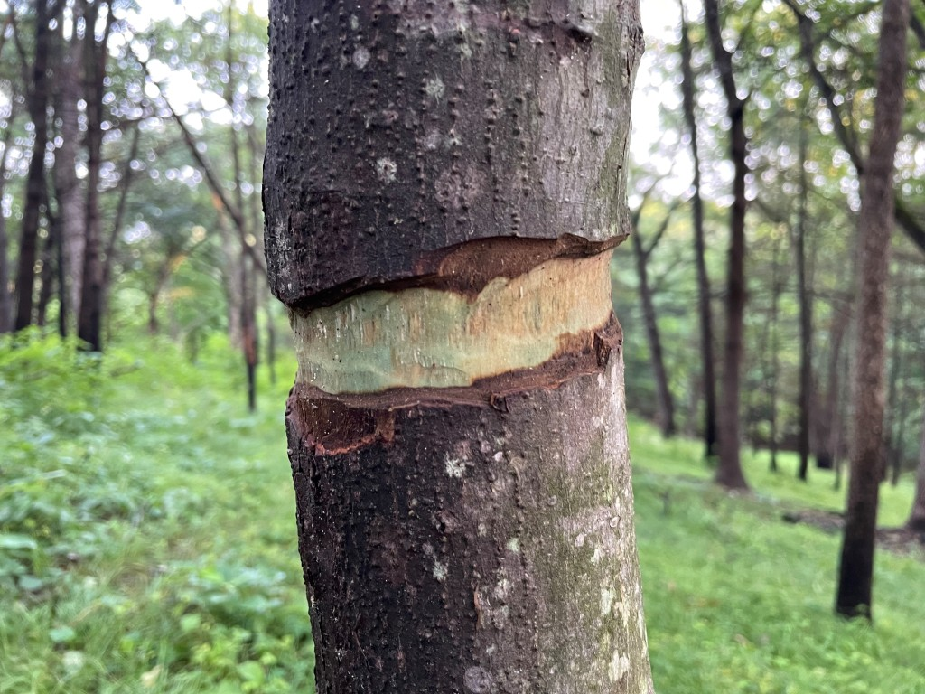
Wood formation
Living wood is on the outside of the stem, which is why bark damage can lead to tree death

Slide 17
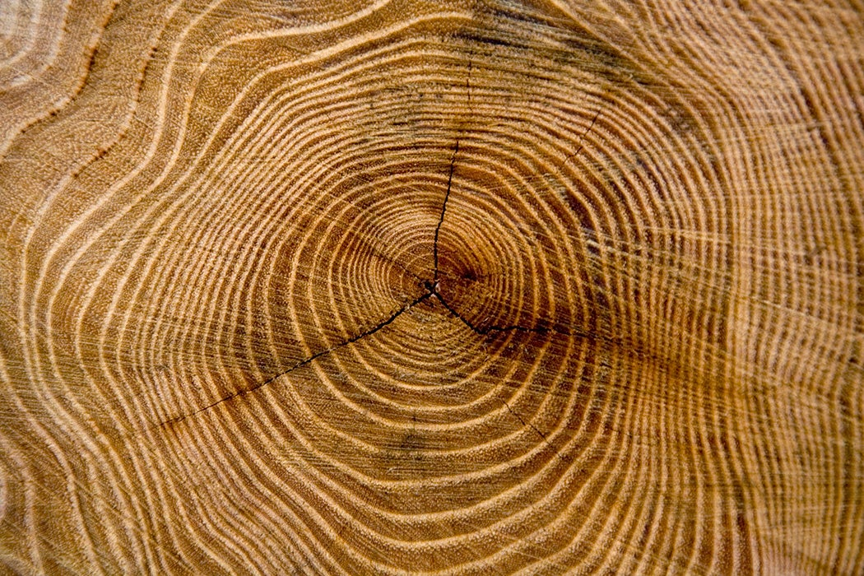
Seasonal wood growth
Some trees grow their wood seasonally just like leaves. This leads to the formation of tree rings.

Slide 18
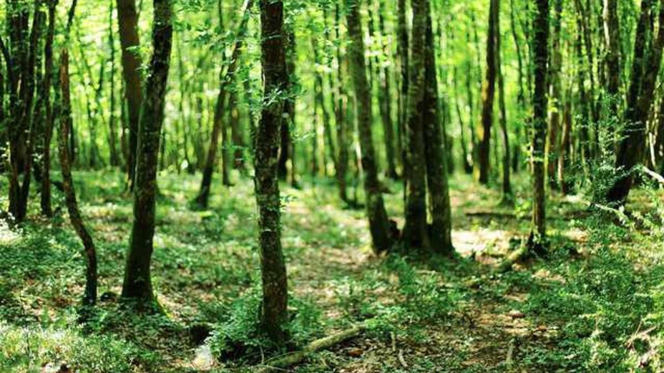
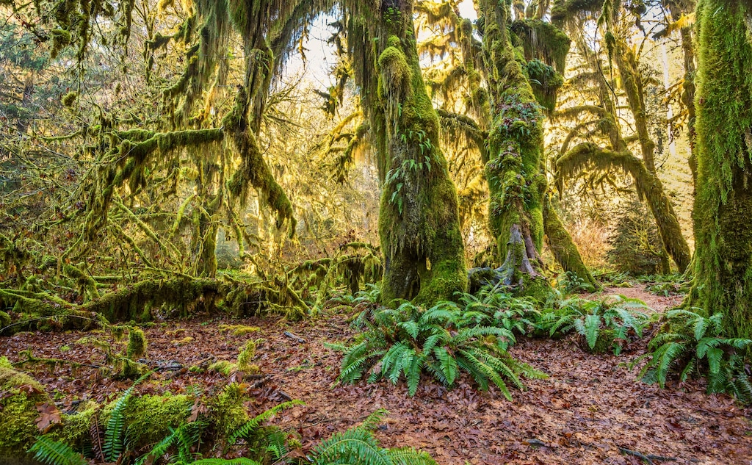
Forests do not grow forever
Forests grow until they reach a resource limitation, usually light

Slide 19
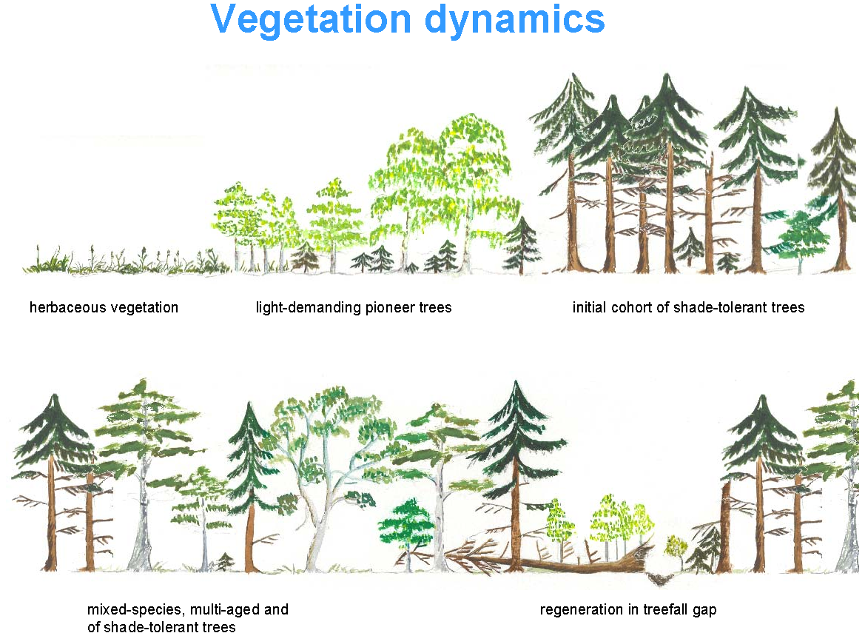
Vegetation cover is not stationary and changes naturally

Slide 20
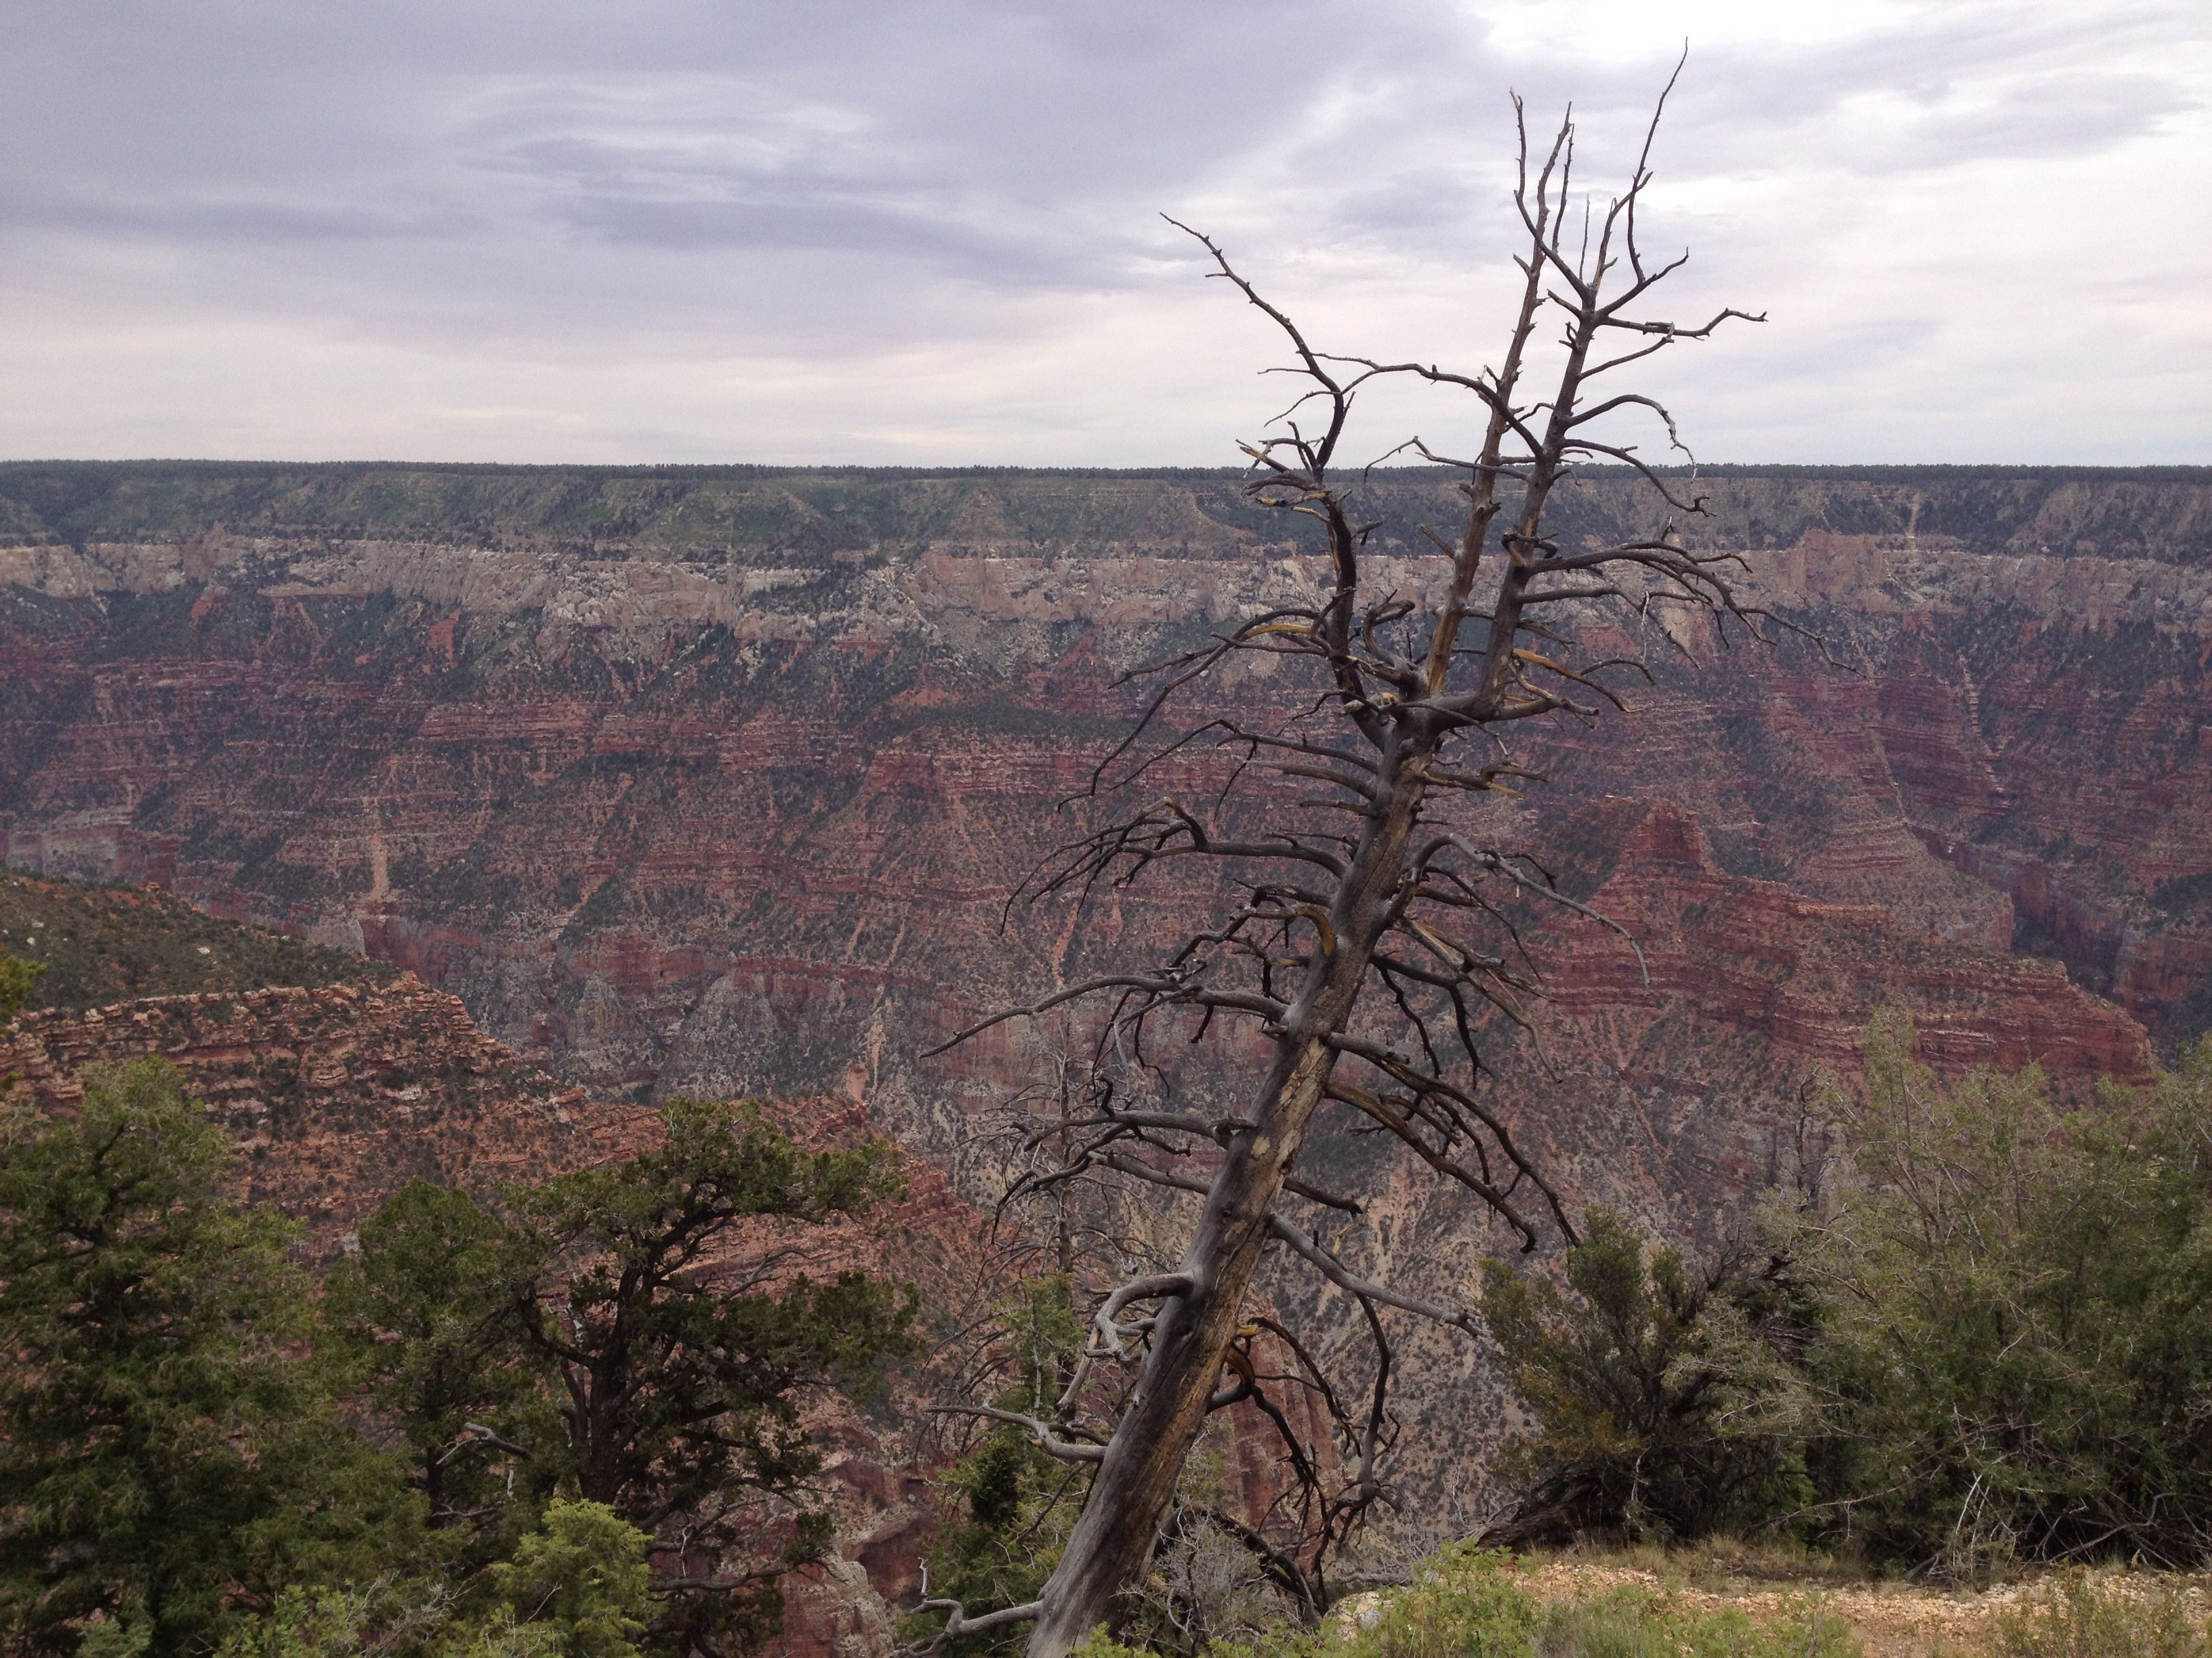
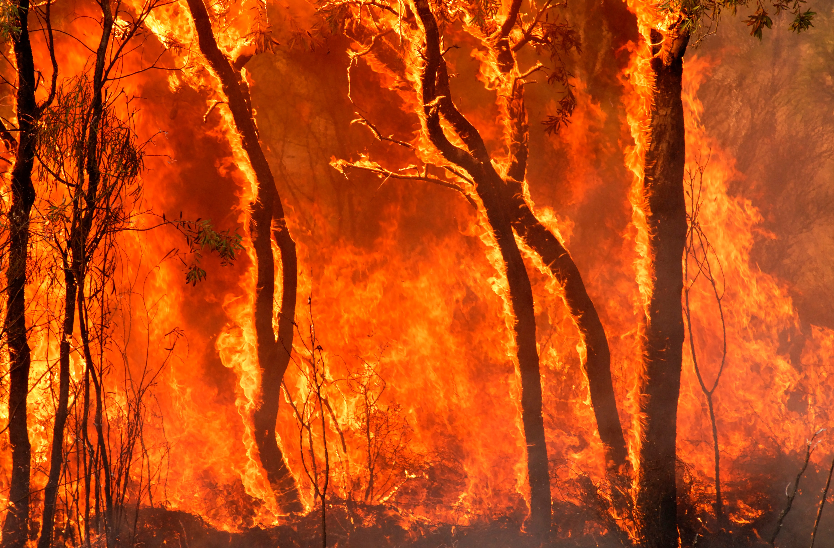
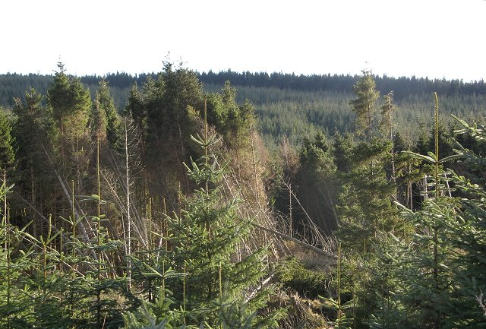
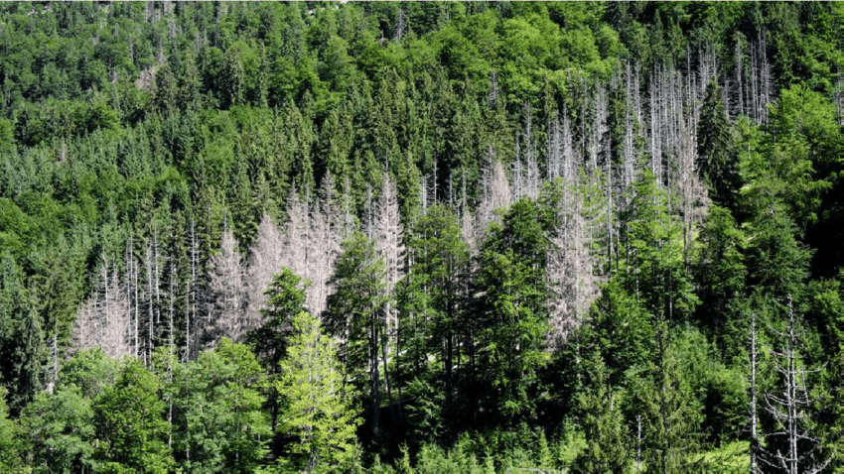
Vegetation cover is not stationary and changes naturally
Forest fires
Drought
Wind throw
Insect attacks

Slide 21
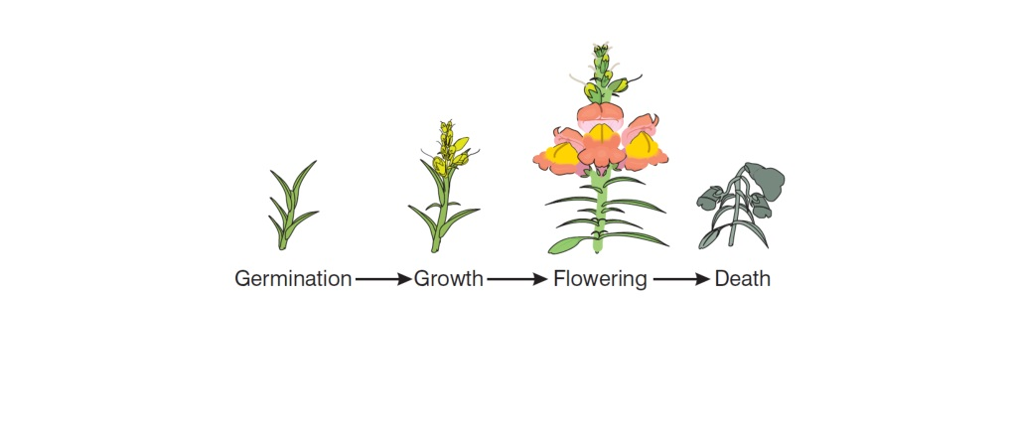
Grasses and short-lived plants
Annual or ephemeral plants store less carbon as biomass in the long term but still draw down C from the atmosphere and store it In soil

Slide 22
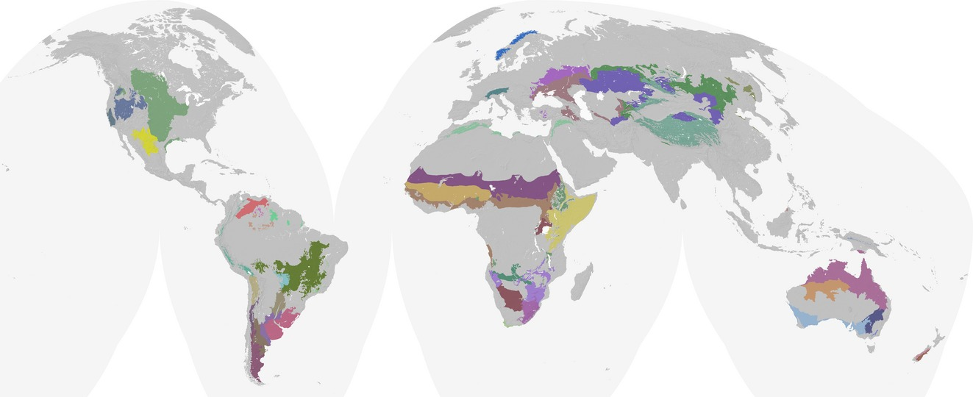
Grasses and short-lived plants

Slide 23
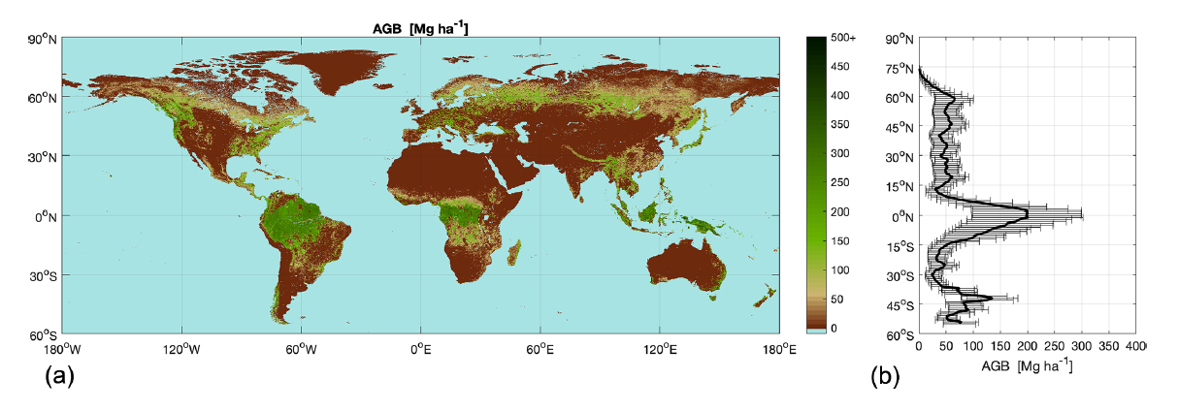
Global forest aboveground biomass

Slide 24
The ecosystem carbon cycle
C uptake:
photosynthesis
C release:
respiration
C release:
Soil respiration
C storage:
growth
Internal cycling::
litterfall
C storage in soil

Slide 26
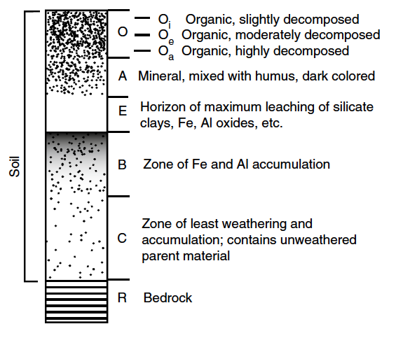
Soil structure
Notes:
Chapin, F.S., Matson, P.A., Mooney, H.A. and Vitousek, P.M., 2002. Principles of terrestrial ecosystem ecology.
Vancouver

Slide 27
Soil structure
Input of plant material as litter
Litter layer
Notes:
Chapin, F.S., Matson, P.A., Mooney, H.A. and Vitousek, P.M., 2002. Principles of terrestrial ecosystem ecology.
Vancouver

Slide 28
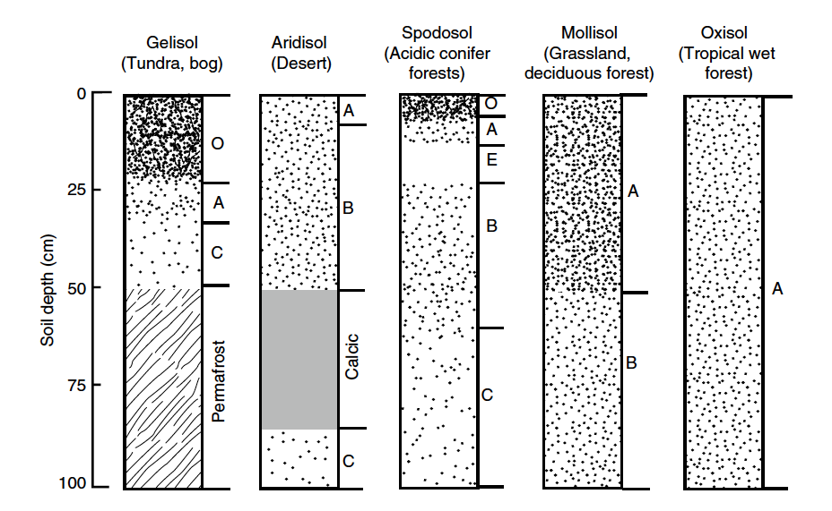
Soil structure with depth differs between ecosystems

Slide 29
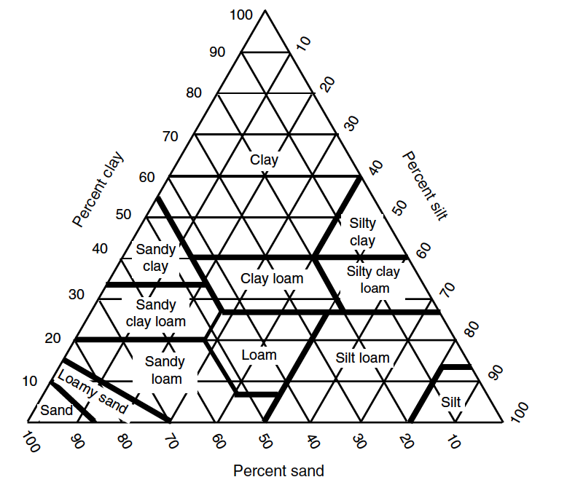
Soil properties
Soil physical properties – texture and density – affect how much water the soil can hold and provide the infrastructure for microbial activity

Slide 30
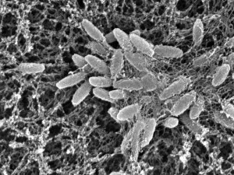
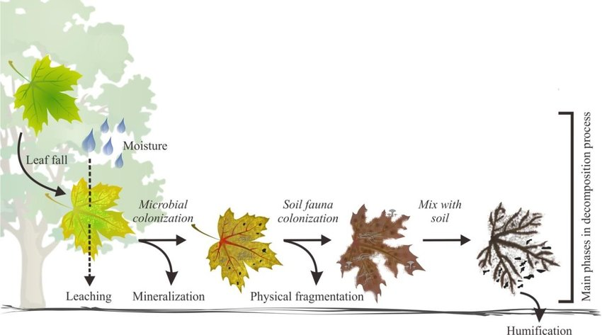
Litter decomposition

Slide 31
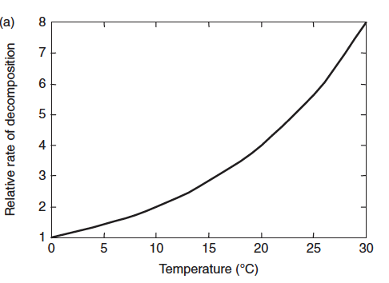
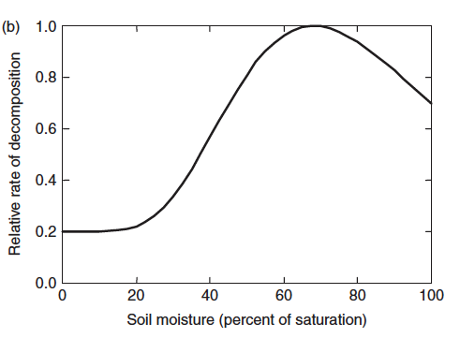
Environmental controls on decomposition

Slide 32
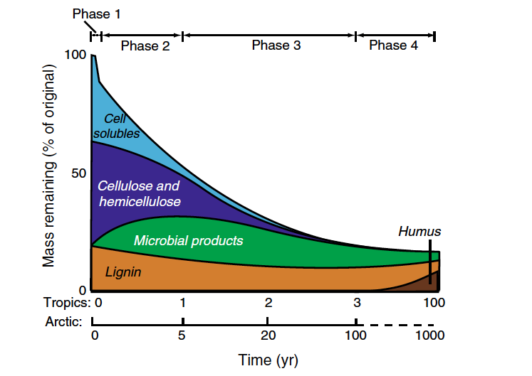
Litter decomposition
Different plant materials are decomposed at different rates in different biomes

Slide 33
Soil organic matter storage
Soil organic matter =
plant litter input - respiration

Slide 34
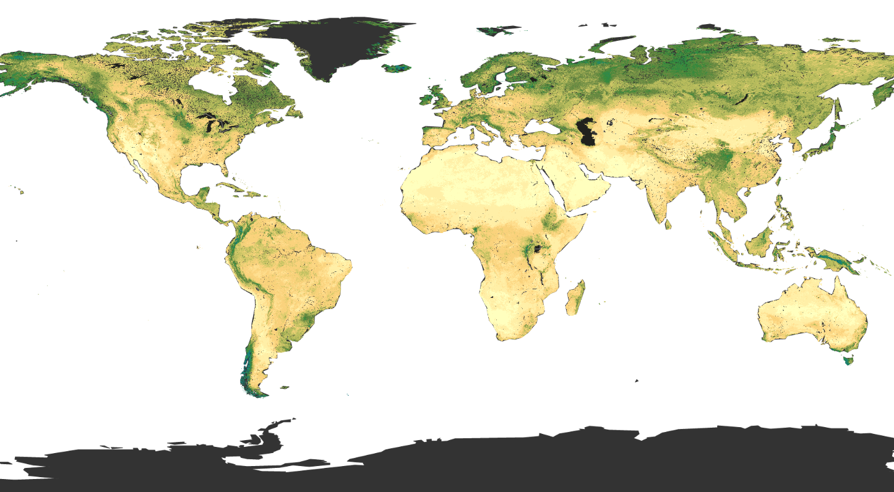
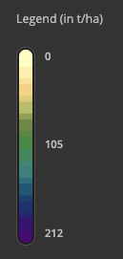
Global soil organic carbon stock
soilgrids.org

Slide 35
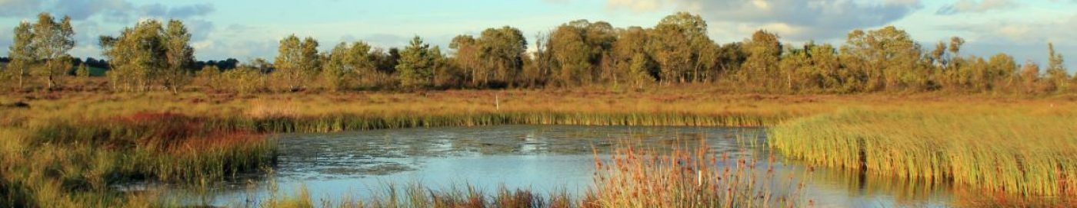
Peatlands
Organic matter accumulates in conditions where it is hard to decompose: waterlogged, infertile soils

Slide 36
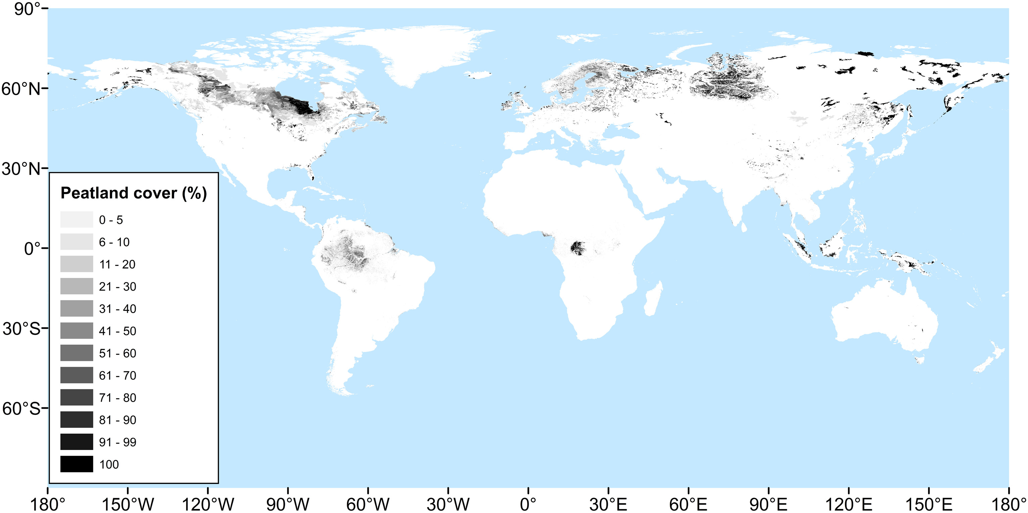
Global peatlands

Slide 37
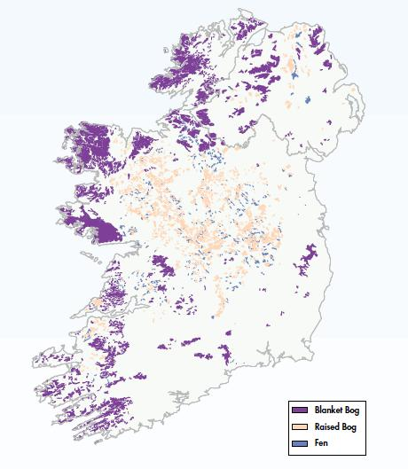
Irish peatlands

Slide 38
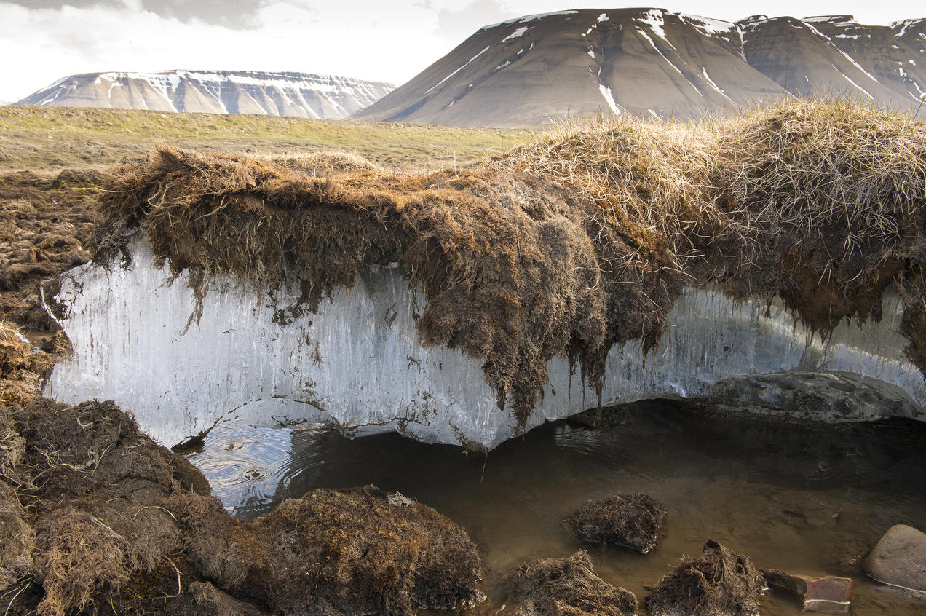
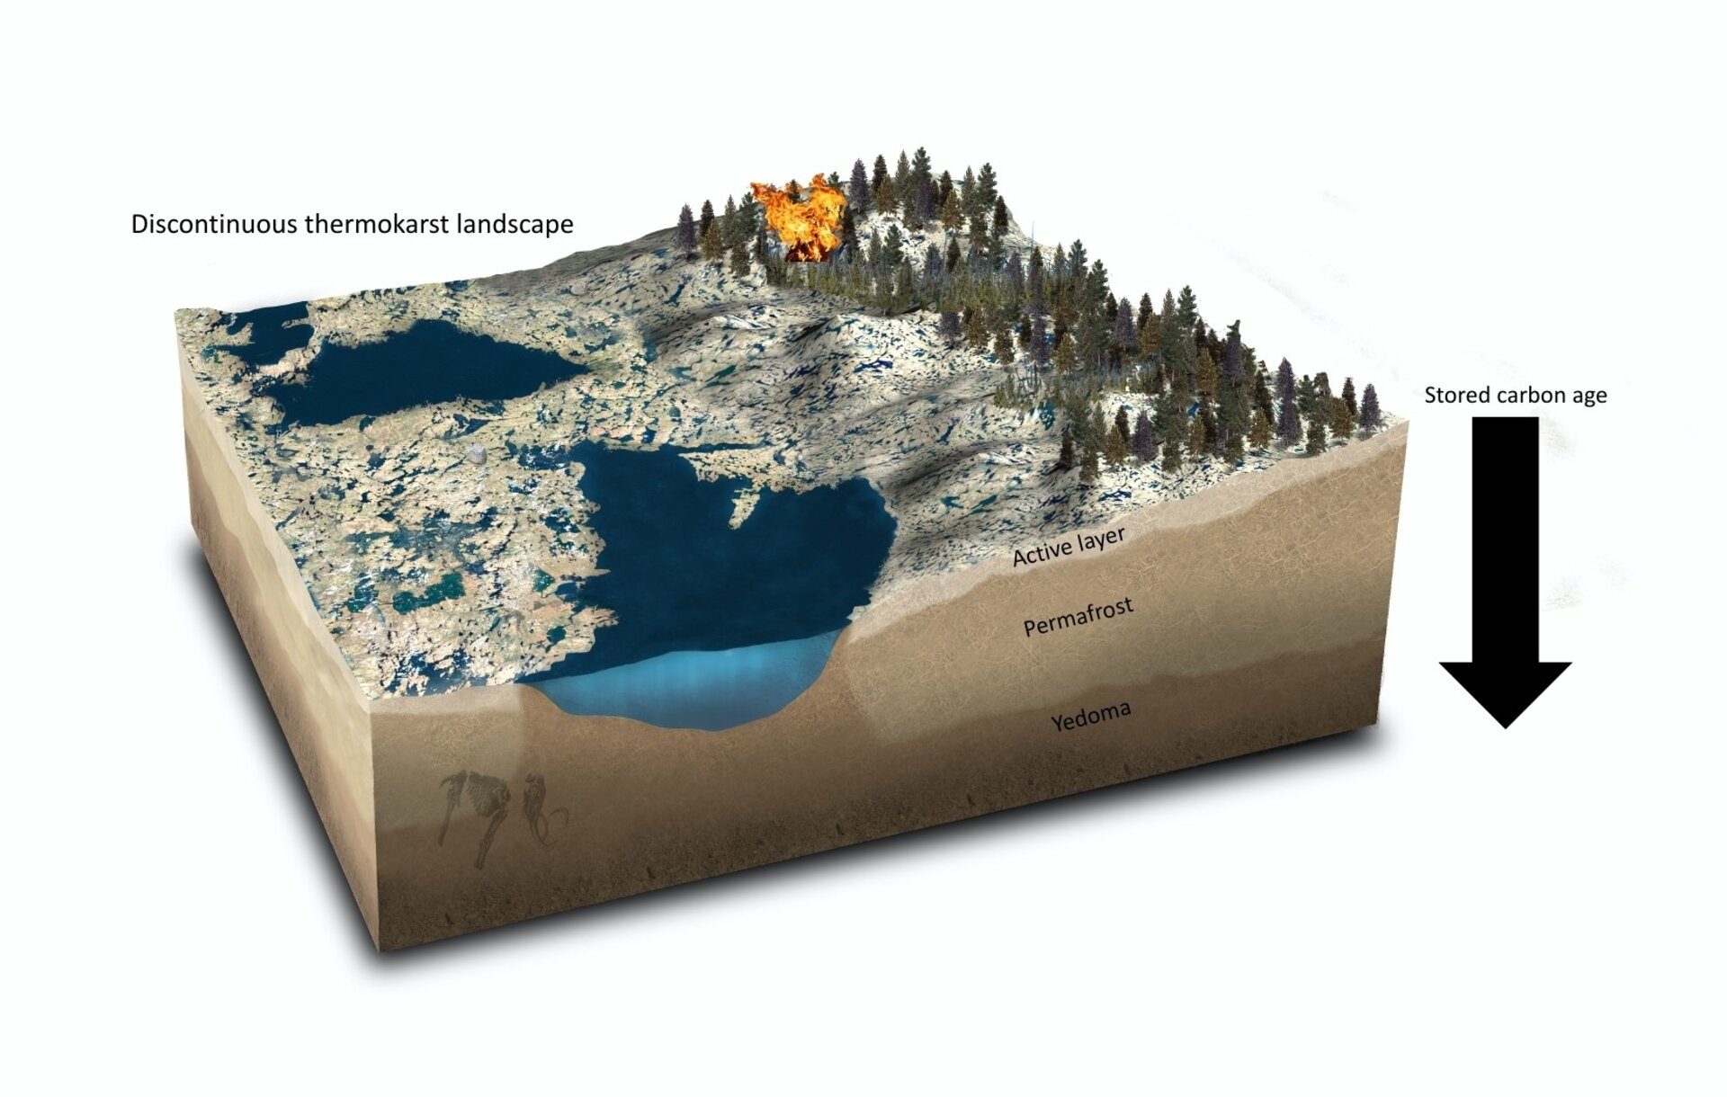
Permafrost
Permafrost is soil that has been frozen for more than 2 years, most frequently hundreds of thousands of years
It contains large amounts of carbon through organic matter that does not decompose

Slide 39
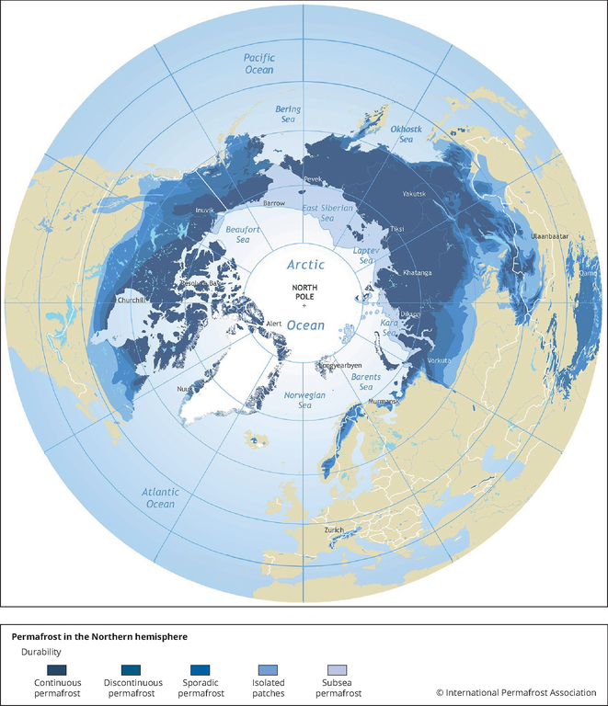
Global permafrost

Slide 40
The ecosystem carbon cycle
C uptake:
photosynthesis
C release:
respiration
C release:
Soil respiration
C storage:
growth
Internal cycling::
litterfall
C storage in soil

Slide 41
Net ecosystem productivity – how much carbon stays in the system?
Net ecosystem productivity = photosynthesis – plant respiration – soil respiration
NEP = GPP – R_{a} – R_{h}
NEP = GPP - R_{eco}

Slide 42
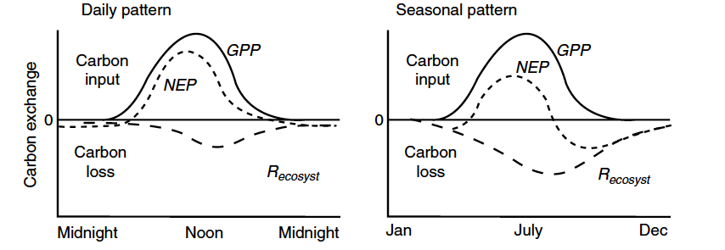
Net ecosystem productivity – how much carbon stays in the system?

Slide 43

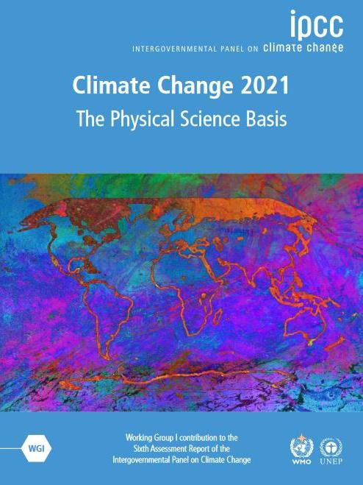
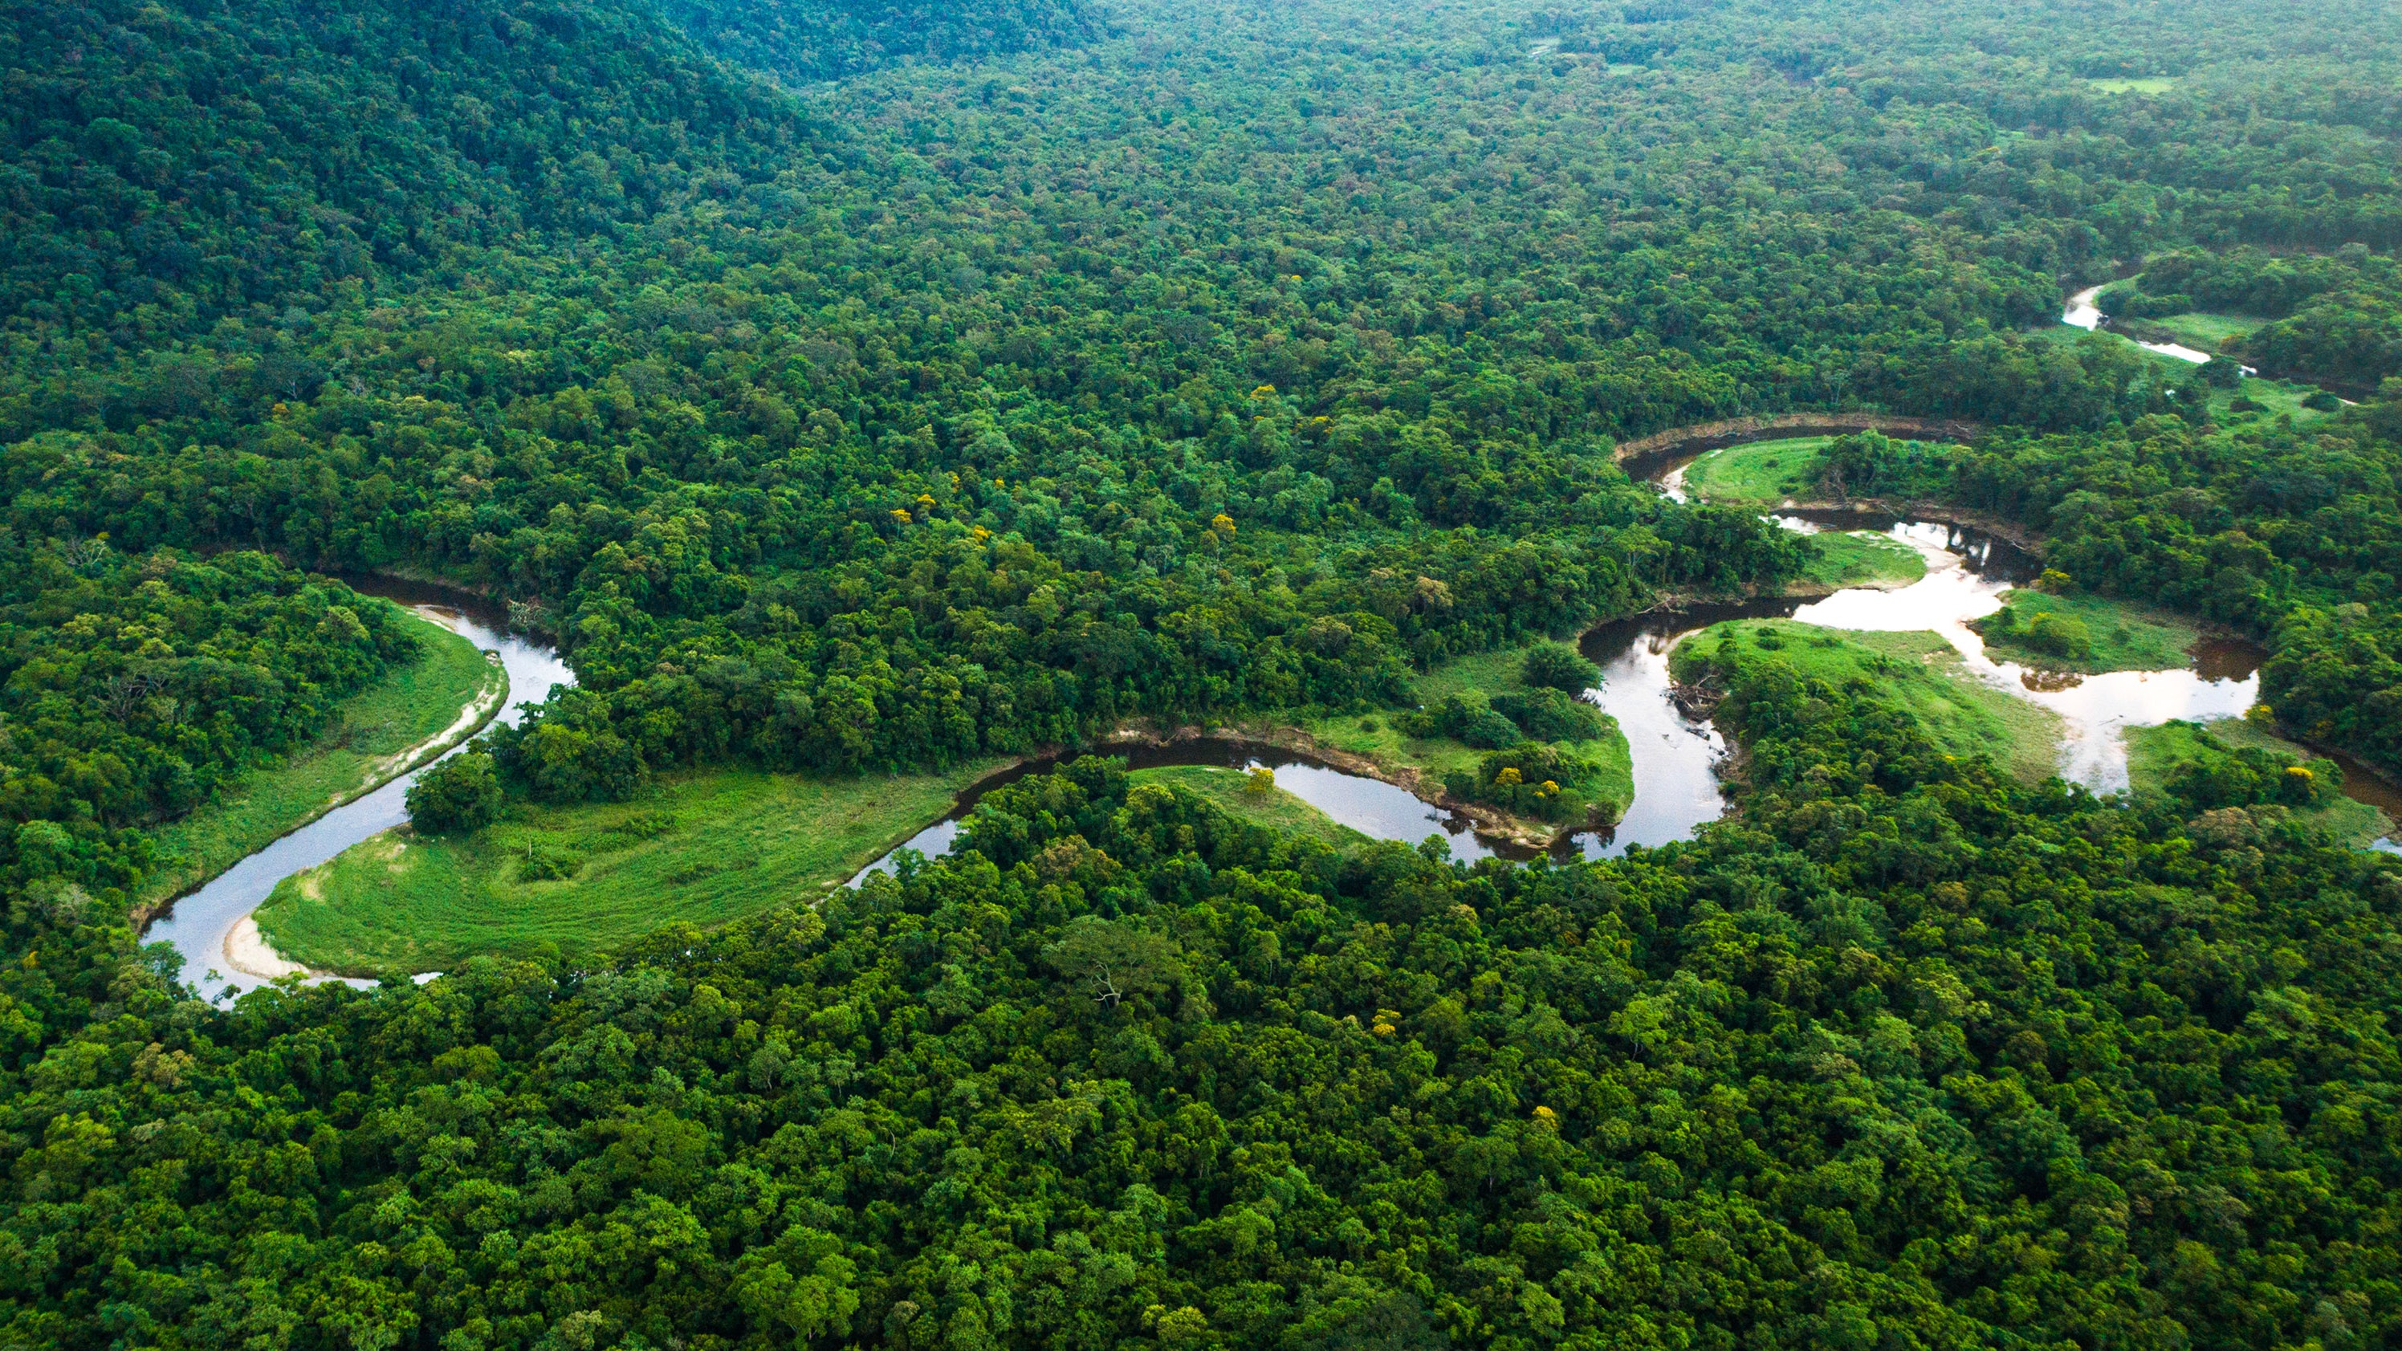

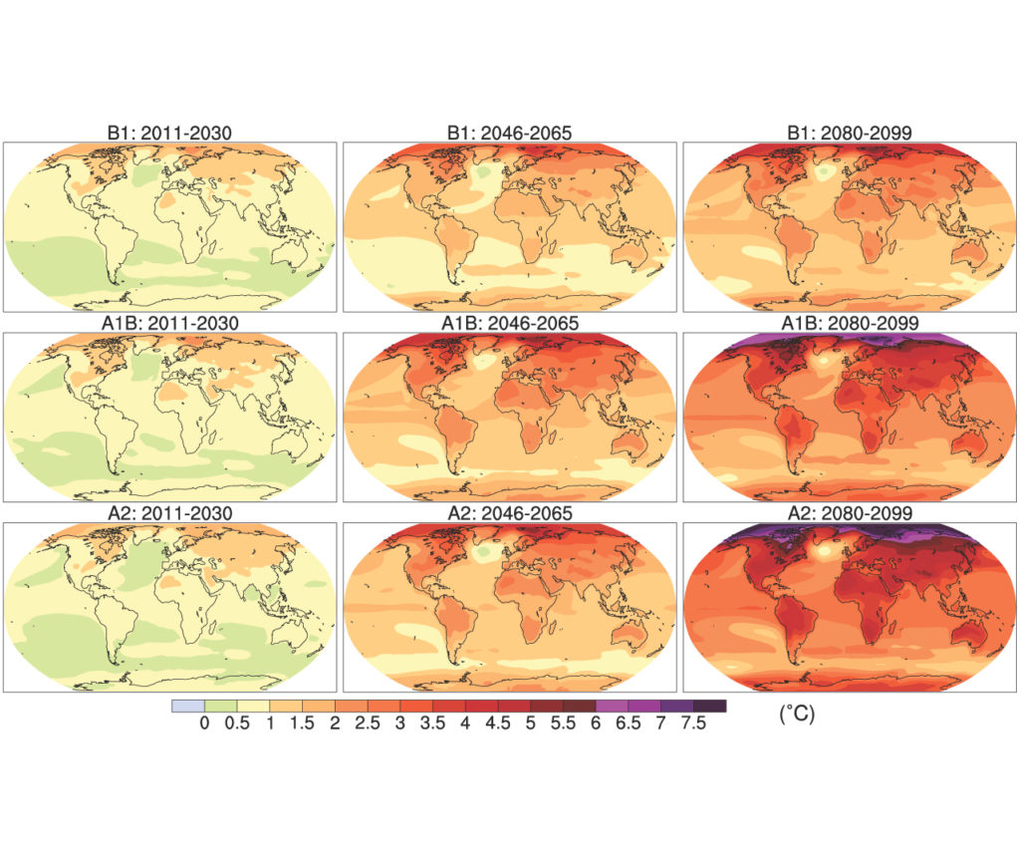
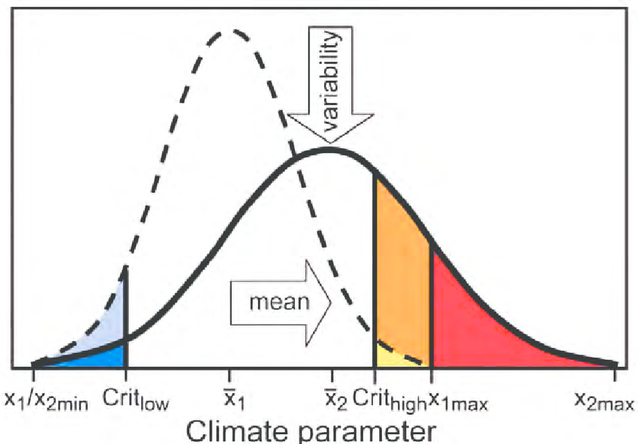
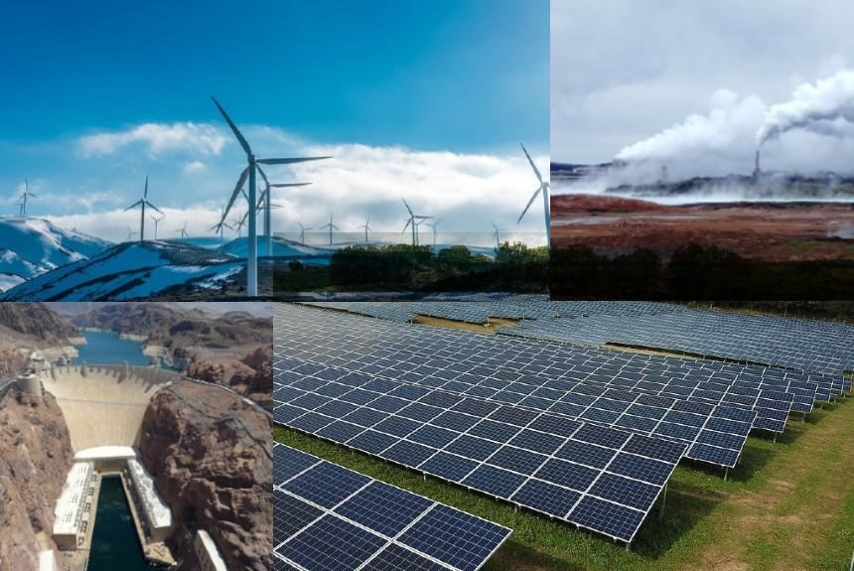
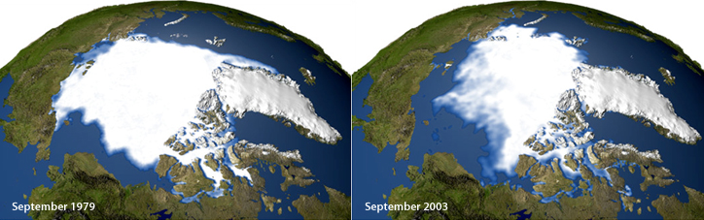
Atmosphere
Climate fundamentals
Predicting climate
Atmosphere
Global C cycle
IPCC report
Earth system models
Climate impacts
Climate solutions
Extreme events
Tipping points
Sea ice, ice caps,
Energy
Mitigation
Nature-based solutions

